Slide 1
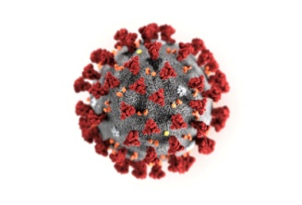


Integral University, integral college of Nursing Lucknow
COVID 19 – Training Modules
Welcome and Introductions
Prepared by
Prof. Ataullah Khan

Slide 2
Welcome and Introductions
Course Faculty
Course Coordinator
Participants

Slide 3
We would like you to introduce yourselves now:
  Who are you?
  What is your professional background?
  What is your experience with COVID 19?
  What do you hope to gain from this course?

Slide 4
Safe Learning Environment
Interactive with stimulus questions
Participation required
Respect for each other
Try answering the questions – it’s ok if you get it wrong

Slide 5
Educational Format
  Introductory lecture
  Interactive group discussions
  Interactive skill sessions
  Written examinations – Pre and Post Test

Slide 6
COVID 19 – Overview, Global Scenario and Immunity Booster
(Module 1)

Slide 7
Global Scenario
WHO declared COVID-19 as pandemic on 11 March 2020
Upto 20 April 2020
  2285210 Cases
  155124 Deceased
  213 Countries
  India – 17265 Cases, 543 Deceased, 32 States
  Mortality more in USA, Italy, France

Slide 8
About Corona
A pneumonia of unknown cause detected in Wuhan, China was first reported to the WHO Country Office in China on 31 December 2019.
WHO is working 24/7 to analyze data, provide advice, coordinate with partners, help countries prepare, increase supplies and manage expert networks.
The outbreak was declared a Public Health Emergency of International Concern on 30 January 2020.
The international community has asked for US$675 million to help protect states with weaker health systems as part of its Strategic Preparedness and Response Plan.
On 11 February 2020, WHO announced a name for the new corona virus disease: COVID-19.

Slide 9
Corona Virus and co-morbidities
More Lethal in persons with low immunity status
Diabetes Mellitus
Chronic Kidney Disease
Immune Suppression
Transplant Patients
Cancer Chemotherapy
Malnutrition
Cardiac disease (Hypertension)
Extremes of age

Slide 10
Corona Virus and Immunity
No Vaccine
No Medicine
Only hope at present
    Prevention
    Immunity boosting

Slide 11
Corona Virus and Immunity
Sound sleep (7-8 hours)
Regular Exercise (at least 30-40 minutes)
Healthy food & food habits
Vitamins C & D
Hydration
Positive Mental Health
Healthy Lifestyle

Slide 12
Corona Virus and Immunity - AYUSH Recommendation
Luke warm water
Practice Yogasana, Pranayam and meditation
Spices – Turmeric, Cumin, Coriander and garlic
Chyavanprash.
Herbal Tea/Decoction – Tulsi, Ginger, black pepper, Cinnamon and Raisin.
Hot milk with Turmeric.
Clove during dry cough
Healthy lifestyle increases immune power

Slide 13






Here some ideas to stay healthy
  Be active
  Eat healthy
  Don’t smoke
  Don’t drink Alcohol
  Meditate
  Read books/Listen music

Slide 14
Any Questions?
?

Slide 15
Summary
Corona Virus is highly infectious
COVID-19 disease is of Global concern
More lethal in comorbidities
At present prevention and immunity boosting are only hope to fight against COVID-19

Slide 16
Clinical Presentation, Prophylaxis and Treatment in adults with Complications
(Module 2)

Slide 17
Learning objectives
To learn mode of transmission of COVID-19
Be able to suspect by symptom analysis
Be able to identify severity of illness
To have knowledge of various complications
To be aware of prophylaxis and treatment

Slide 18
Introduction
Corona virus comprises of a large family of viruses that are common in human beings as well animals (camels, cattle, cats, and bats).
There are seven different strains of corona virus.
Sometimes corona virus from animals infect people and spread further via human to human transmission such as with MERS-CoV, SARS-CoV, and now with this COVID 19 (Corona disease 2019).
The virus that causes COVID-19 is designated severe acute respiratory syndrome corona virus 2 (SARS-CoV-2); previously, referred to as 2019-nCoV.

Slide 19



Transmission
Droplet transmission
Other possible modes of transmission- by touching a surface or object that has the virus on it and then touching their own mouth, nose, or possibly their eyes, but this is not thought to be the main way the virus spreads.
Virus may also be present in feces

Slide 20
Clinical Features
Incubation period- 2 to 14 days after exposure, mostly within 5 days after exposure
Age affected -Mostly middle aged (>30 years) and elderly and usually mild infection in children

Slide 21
Clinical Features
  Nausea or vomiting (5.0%),
  Nasal congestion (4.8%),
  Diarrhea (3.7%), and
  Hemoptysis (0.9%), and
  Conjunctival congestion (0.8%)
  ARDS (3%)
  Abnormalities on chest X-ray (59%)
  Radiological findings on chest CT scan (86%)
  Fever (87.9%),
  Dry cough (67.7%),
  Fatigue (38.1%),
  Sputum production (33.4%),
  Shortness of breath (18.6%),
  Sore throat (13.9%),
  Headache (13.6%),
  Myalgia or arthralgia (14.8%),
  Chills (11.4%),
(Adapted from Report of the World health organization (WHO)-China Joint Mission on Coronavirus Disease 2019 based on 55,924 cases and a study on 1099 cases by Guan et al published in N Eng J Med)

Slide 22
Spectrum of disease activity
Mild cases- low grade fever/cough/malaise/rhinorrhea/sore throat WITHOUT any shortness of breath
Moderate- Severe illness :Any one of: 1. Respiratory rate > 24 /min 2. SpO2 < 94% on room air
COVID-19 pneumonitis
Septic shock

Slide 23
Case Definition (When to suspect?)
All symptomatic individuals who have undertaken international travel in the last 14 days
or
All symptomatic contacts of laboratory confirmed cases
or
All symptomatic healthcare personnel (HCP)
or
Hospitalized patients with fever AND cough and/or shortness of breath
or

Slide 24
Case Definition (When to suspect?)
Asymptomatic direct and high risk contacts of a confirmed case (should be tested once between day 5 and day 14 after contact)
In Hotspots/cluster (as per MoHFW) and in large migration gatherings/evacuees centers: All symptomatic Influenza like illness (fever, cough, sore throat, runny nose)
Symptomatic refers to fever/cough/shortness of breath.
Direct and high-risk contacts include those who live in the same household with a confirmed case and
HCP who examined a confirmed case without PPE or with a breach in PPE

Slide 25
Confirmed Case
A person with laboratory confirmation of virus causing COVID-19 infection, irrespective of clinical signs and symptoms

Slide 26
Close Contacts
Close contact of a probable or confirmed case is defined as
A person living in the same household as a COVID-19 case;
A person having had direct physical contact with a COVID-19 case (e.g. shaking hands);
A person having unprotected direct contact with infectious secretions of a COVID-19 case
A person having had face-to-face contact with a COVID-19 case within 2 metres and > 15 minutes;

Slide 27
Close Contacts
A person who was in a closed environment with a COVID-19 case for 15 minutes or more and at a distance of less than 2 metres
A healthcare worker (HCW) or other person providing direct care for a COVID-19 case, or laboratory workers handling specimens from a COVID-19 case without recommended personal protective equipment (PPE) or with a possible breach of PPE

Slide 28
Recommendations for sample collection
Collection of specimens to test for SARS-CoV-2 from the upper respiratory tract (nasopharyngeal and oropharyngeal swab) is the preferred method for diagnosis
Preferred sample: Throat and nasal swab in viral transport media (VTM) and transported on ice
Alternate: Nasopharyngeal swab, BAL or endotracheal aspirate which has to be mixed with the viral transport medium and transported on ice
Induction of sputum collection is not recommended

Slide 29
Current recommended diagnostic modality for COVID-19
SARS-CoV-2 RNA is detected by polymerase chain reaction (RT-PCR)
Results are generally available within a few hours to 2 days
A single positive test should be confirmed by a second RT-PCR assay targeting a different SARS-CoV-2 gene
If initial testing is negative but the suspicion for COVID-19 remains, the WHO recommends re-sampling and testing from multiple respiratory tract sites
For safety reasons, specimens from a patient with suspected or documented COVID-19 should not be submitted for viral culture.
Samples should also be tested for other viral/bacterial pathogens.

Slide 30
Recommendations for sample collection
INDIAN COUNCIL OF MEDICAL RESEARCH DEPARTMENT OF HEALTH RESEARCH Strategy for COVID19 testing in India (Version 4, dated 09/04/2020)
All symptomatic individuals who have undertaken international travel in the last 14 days
All symptomatic contacts of laboratory confirmed cases
All symptomatic health care workers
All patients with Severe Acute Respiratory Illness (fever AND cough and/or shortness of breath)
Asymptomatic direct and high-risk contacts of a confirmed case should be tested once between day 5 and day 14 of coming in his/her contact, In hotspots/cluster (as per MoHFW) and in large migration gatherings/ evacuees centres
6. All symptomatic ILI (fever, cough, sore throat, runny nose)
Within 7 days of illness – rRT-PCR
b. After 7 days of illness – Antibody test (If negative, confirmed by rRT-PCR)

Slide 31
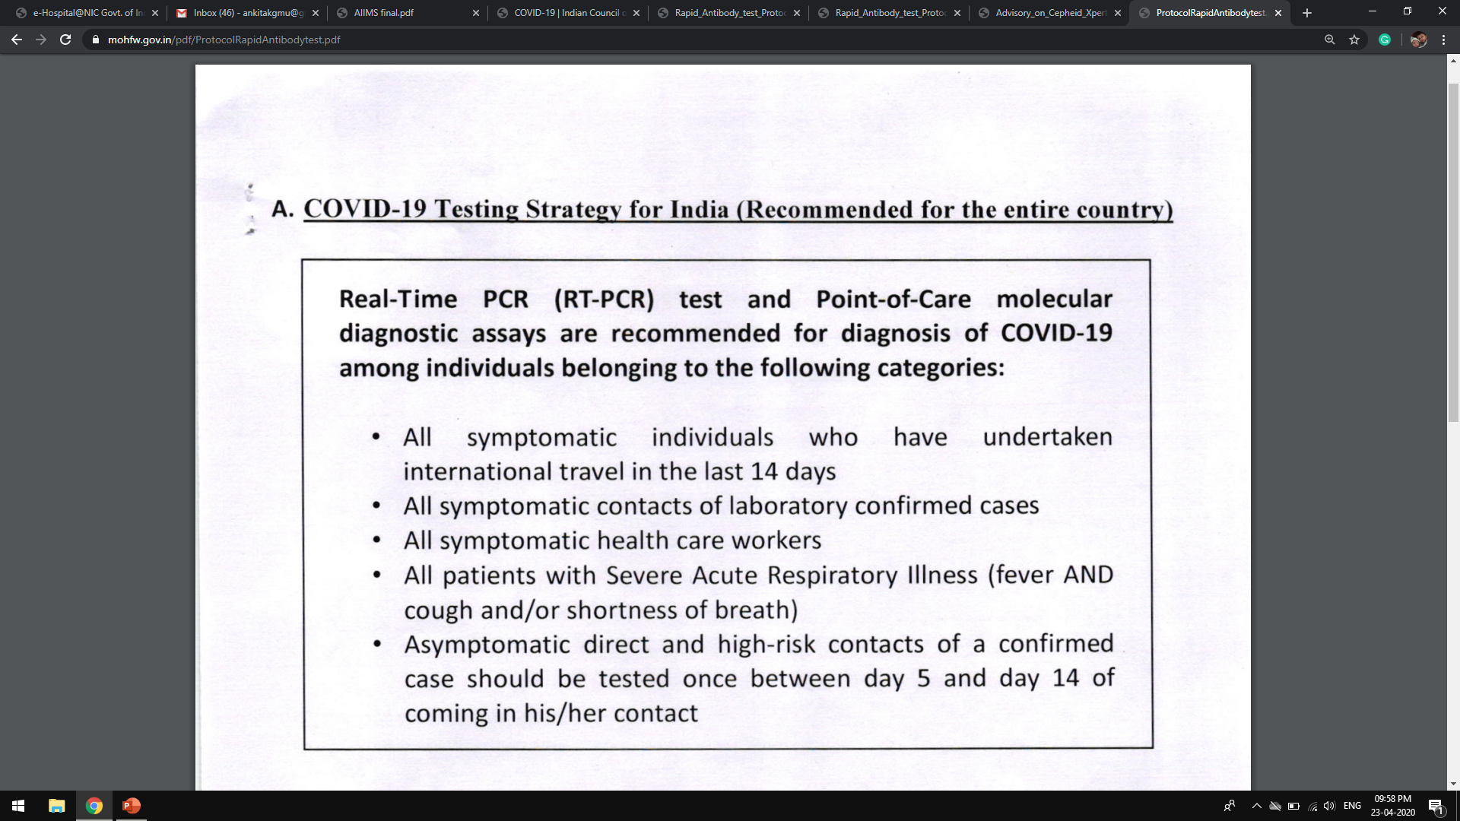

Slide 32
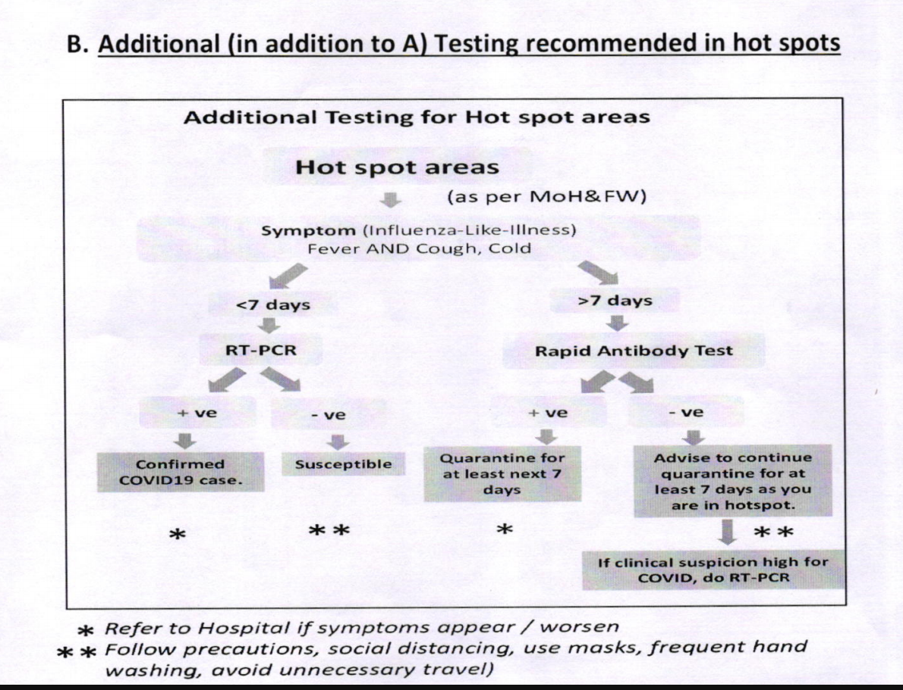

Slide 33

Prophylaxis
Eligible individuals and doses:
A. Asymptomatic health care workers involved in care of suspected or confirmed cases of covid-19: 400 mg BD on day 1 followed by 400 mg once weekly for next 7 weeks with meals
B. Asymptomatic household contacts of laboratory confirmed cases: 400 mg BD on day 1 followed by 400 mg once weekly for next 3 weeks with meals

Slide 34
Treatment-Mild disease
Contact & droplet precautions; strict hand hygiene
Symptomatic management
Tab HCQ (400 mg BD x 1 day f/b 400 mg OD x 4 days ) may be considered in those with any of the high risk features
*High-risk for severe disease
    1. Age > 60 years
    2. Cardiovascular disease including hypertension
    3. DM and other immunocompromised states
    4. Chronic lung/kidney/liver disease
    5. Cerebrovascular disease

Slide 35
Treatment-Moderate/ severe disease
Any one of:
1. Respiratory rate > 24 /min
2. SpO2 < 94% on room air
Consider Tab HCQ (400 mg BD x 1 day f/b 400 mg OD x 4 days)
Oxygen Support: Target SpO2: 92-96% (88-92% in patients with COPD)
Symptomatic and supportive treatment (antipyretics, antibiotics, etc. as per existing protocol)

Slide 36
Chloroquine / hydroxychloroquine
Proposed mechanism- Hampers the low pH dependant steps of viral replication
No renal or hepatic dose adjustments necessary
Has been even proposed for prophylaxis- however lacks evidence
Side effects: QT prolongation

Slide 37



When to discharge patient ??
Resolution of symptoms
Radiological improvement
Documented virological clearance in 2 samples at least 24 hours apart

Slide 38
Conclusion
Corona virus disease 2019 (COVID-19) was reported as cluster of disease in China in December 2019
It has since spread to all continents except Antarctica and WHO declared COVID-19 as a pandemic.
Elderly persons with co-morbidities are more affected
It spreads mainly via Respiratory droplets
Pneumonia is the most common complication
Severe cases have a mortality rate of 2.3 to 5%
Presently there is no standardized treatment or vaccine available for COVID-10
Containment and prevention is the best option.

Slide 39
Any Questions?
?

Slide 40
Summary
COVID-19 is mainly transmitted by droplets, surface contacts and fomites
Its usual incubation period is 2-14 days
High fever, Dry cough and Breathlessness are main symptoms of illness
Illness can be mild, moderate or severe
81% cases are either asymptomatic or mild
Fatality is mainly due to pneumonia and its related complications

Slide 41
HOW TO CONFIRM COVID 19:
Sample Collection, Packing & Transport
(Module 3)

Slide 42
Learning Objectives
Precautions to be taken while collecting the Nasal and Oropharyngeal swabs
Whom to test?
Testing Strategy for COVID 19 patients
Labelling of Specimen
How to fill requisition form?
How to collect Nasal and Throat swabs?
What is Viral Transport medium (VTM)
Packaging and transport of VTM with swab to the lab
Acceptance and rejection criteria of specimen in the lab

Slide 43
General Precautions
Consider all specimens as POTENTIALLY HAZARDOUS / INFECTIOUS
Handle all specimens with gloves
Ensure that VTM vial is labeled properly
Do not contaminate the outside of the specimen container
Send the laboratory requisition forms covered in plastic

Slide 44
WHOM TO TEST AND WHEN TO TEST; GUIDELINES OF ICMR 09.4.2020
All symptomatic people who have undertaken international travel in last 14 days
All contacts of laboratory confirmed positive cases
Health care workers managing respiratory distress / Severe illness should be tested when they are symptomatic.
All patients with Severe Acute Respiratory Illness (fever AND cough and/or shortness of breath)
Asymptomatic direct and high-risk contacts of a confirmed case should be tested once between day 5 and day 14 of coming in his/her contact (In hotspots/cluster (as per MoHFW) and in large migration gatherings/ evacuees centres)
All symptomatic ILI (fever, cough, sore throat, runny nose)

Slide 45
Whom To Test And When To Test; Guidelines Of ICMR For Pregnant Females
Pregnant women residing in clusters/containment area or in large migration gatherings/evacuees centre from hotspot districts presenting in labour or likely to deliver in next 5 days should be tested even if asymptomatic

Slide 46
Retesting strategy for COVID 19 PCR positive patients as per ICMR
Every Alternate day/48hr NS & TS sample are to be sent for PCR testing; till the 2 sample become negative.

Slide 47
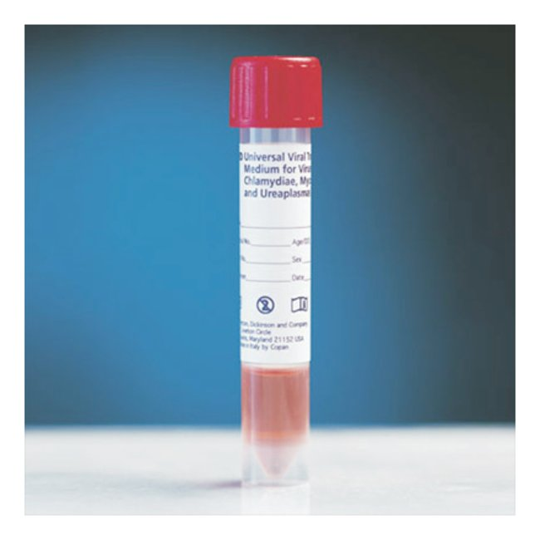
Labeling of Specimens
Specimens for laboratory testing should have labels
Label should include
    Patient’s name
    Age & gender
    Patient’s unique identification number/hospital registration number
    Hospital/Ward
Label specimens using marker pen & put a celloptape to protect ink from fading away
Tighten the tube cap and may use the tube with cellotape to seal the cap.

Slide 48
Requisition form
All specimens must be accompanied by a requisition form with the following details:
  Hospital/Laboratory Name
  Patient Identification Number
  Patient Name, Age/Gender
  Patient Contact Details (phone, email, address)
  Travel and contact history
  Date and Time of collection and sending to the laboratory
  Type, source, and volume of specimen
  Brief clinical history and relevant investigational results
  Test Required
  Sender’s signature

Slide 50
USE Personal Protective Equipments for Sample collection
Donning full PPE, before collecting COVID 1
Patient sample
Doffing PPE carefully as described previously

Slide 51
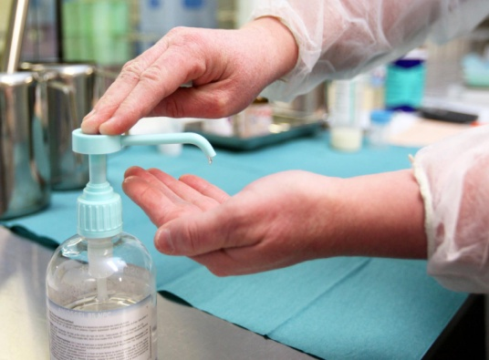
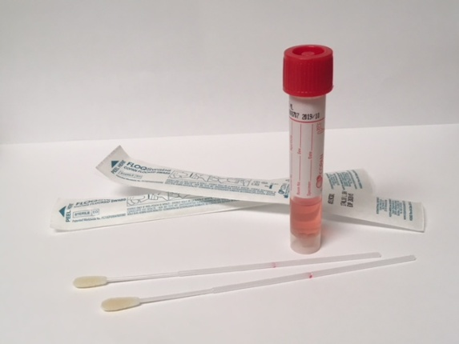
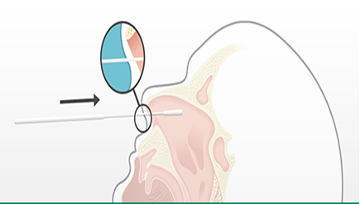
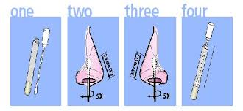
Nasal Swab Collection
Nasal Swab is collected from the
anterior turbinate
Insert dry swab into nostril upto 1 inch.
Slowly remove swab while slightly rotating it
Use a same swab for another nostril.
Put tip of swab into vial containing VTM, breaking applicator’s stick.

Slide 52
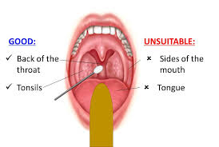
Throat Swab collection
Have the patient open his/her mouth wide open
Use tongue depressor
Sweep the swab over the back of throat including tonsils
Send both nasal and throat swab of one patient in a single VTM tube.
Send filed requisition form also

Slide 53

Transport Conditions
Specimen | Media | Temperature
Nasal swab/Throat swab | VTM | 2-8 ⁰C
NPA/ swab | VTM | 2-8 ⁰C
Transport the specimen immediately to Microbiology laboratory

Slide 54
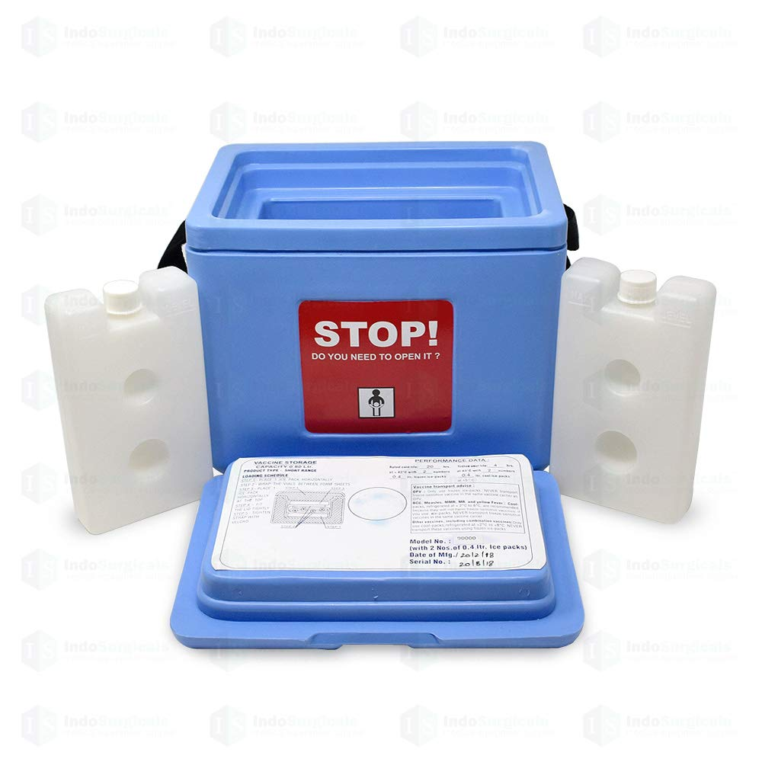

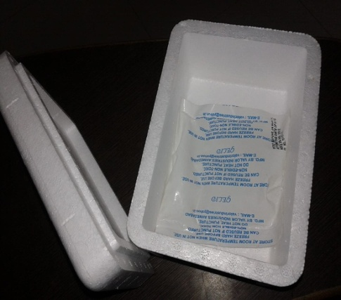
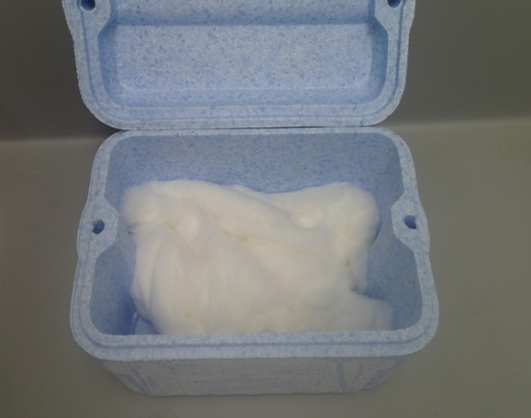

Packaging & Transport at KGMU
Put the sealed samples in the thermacol box/
vaccine carrier with frozen ice packs.
Put enough cotton and pack the samples.
Seal the box with cellotape
Label it as ‘Sample of COVID 19 patient’ with
Biohazard sign.
Send along with filled and complete
requisition form.

Slide 55

Acceptance Criteria
Ensure that the specimens are properly labeled with unique identification number and date
Cross check the specimen label (unique identification number and date) with the request form
Ensure that the specimen received is in good condition
Record all primary specimens in the laboratory register/computer after receiving them in the laboratory

Slide 56

Rejection Criteria:
Unsuitable Specimen for Procedure
  Reject specimens which are unsuitable (e.g. leaking/broken specimen container)for the procedure requested or if the specimen has been in transit too long for a valid result.
  Improperly or unlabelled.
  With no or incomplete case sheet.

Slide 57
Learning Objectives
Precautions to be taken while collecting the Nasal and Oropharyngeal swabs
Whom to test?
Testing Strategy for COVID 19 patients
Labelling of Specimen
How to fill requisition form?
How to collect Nasal and Throat swabs?
What is Viral Transport medium (VTM)
Packaging and transport of VTM with swab to the lab
Acceptance and rejection criteria of specimen in the lab

Slide 58
Any Questions?
?

Slide 59
Summary
Collect the sample cautiously wearing the PPE
Label the VTM vial properly and tape the cap.
Send the VTM with ice pack.
Do not contaminate the sample box surface
Fill the requisition form completely and transport along with the sample box in a plastic cover

Slide 60
Hand hygiene, Donning & Doffing of Mask
(Module 4)

Slide 61
Learning Objectives
To know the importance of hand hygiene
To know when to do a hand hygiene
To know the methods of hand hygiene
To know the correct steps of hand hygiene
To know the mask types
To know the correct method of wearing a mask

Slide 62
Hand Hygiene

Slide 63
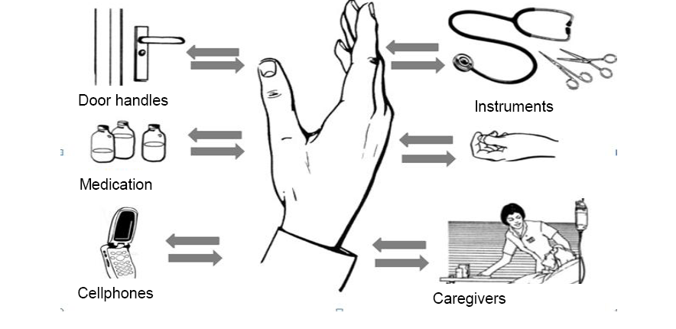
WHY is hand hygiene required`?

Slide 64
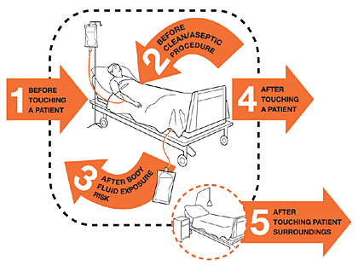
WHEN do we need to practice hand hygiene?
WHO guidelines on hand hygiene in health care, 2009
Notes:
My 5 moments of hand Hygiene

Slide 65
When is hand hygiene a must?
Before
  touching any devices/equipment attached to patient
    Indwelling catheter
    Any other drain
    Ventilation equipment
  Drawing a specimen/placing IV line
After
  All above activities
  After touching door/ almirah handles
  Handling patient chart/monitor
  Touching own nose/mouth/hair
  After touching any surface in the patient environment

Slide 66
WHICH: Hand wash or hand rub?
Time required (for hand wash 40-60 secs vs. for hand rub ~20 secs)
After hand wash- Need towels to wipe
Location of washbasin- not at point of care
WHO recommends-for all clinical situations, preferred use of hand rub if available, except when hands are soiled (Do Hand wash).

Slide 67
Hand wash recommendations:
Hand wash is a must
  After Using PPE
  After taking off the gloves
  When hands are visibly contaminated with blood/body fluids
  Patients with Clostridium difficile or enteroviral diarrhea
  After using the toilet
  Before and after eating

Slide 68
Steps of hand rub/Hand wash
Remove Jewellery before hand rub/hand wash
Duration for hand rub: 15-20 seconds
Duration for hand wash: 40-60 s
Volume of hand sanitizer: ~ 3 ml
Volume of soap (medicated): enough to produce leather
VERY IMPORTANT: Rub hands together until dry (for Hand rub)

Slide 69
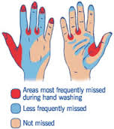
Why do we need steps of hand hygiene?

Slide 70
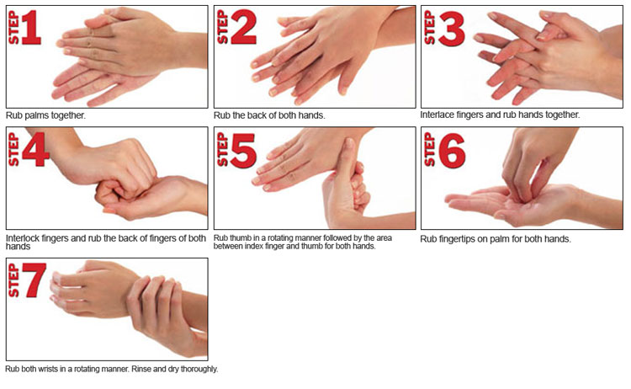
Steps of hand rub/ hand wash
SUIMAN- K

Slide 71
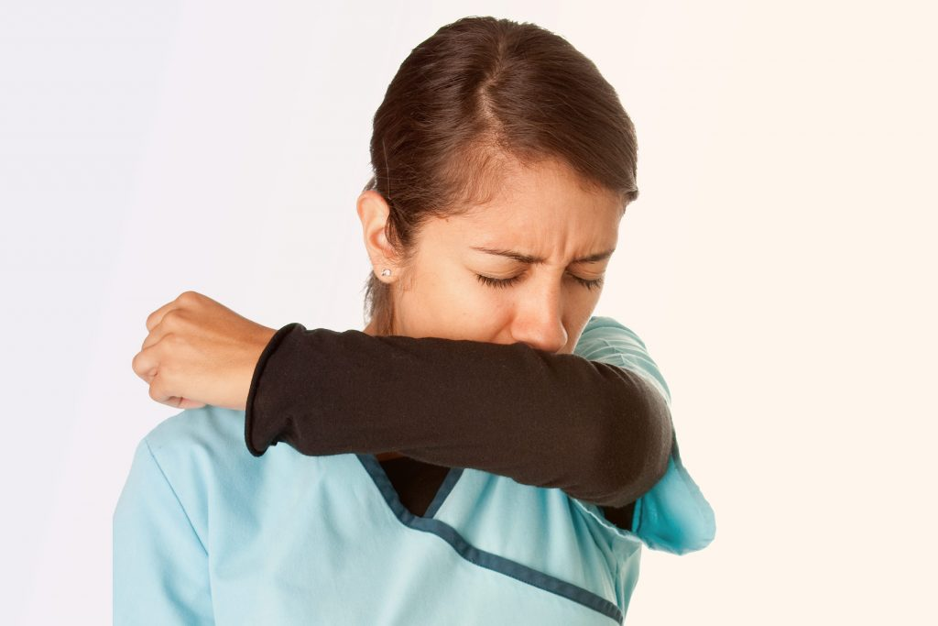
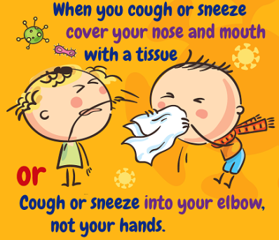

Respiratory hygiene
Avoid patient care areas if you have a respiratory infection. Stay home if possible.
Wear a mask during hospital visits.
Wash hands with soap and water

Slide 72
Type of Mask
Surgical- Triple layered
  Typically donned for a specific procedure (eg: surgery by a surgeon) and disposed of afterward.
  Prevent large particles expelled by the wearer,
  have higher requirements for capturing virus-sized (0.1 micron) particles
  do not fit tightly to the face
N 95- Non oil resistant (US standard); China (KN 95); Europe (FFP2)

Slide 73
How to wear face Mask with side straps?

Slide 74
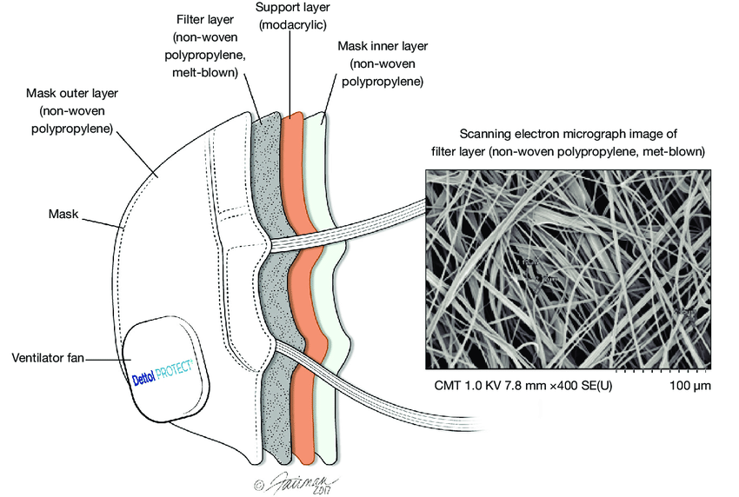
N 95 Mask
Masks- Use-N 95
  To examine known COVID 19 positive
  patient
  When taking samples from COVID 19 suspect case
  When doing bacterial cultures of
  COVID suspect/ conformed respiratory samples.
  When doing RNA extraction in lab.
  (If N 95 is not available use triple layered surgical mask. Use triple layered for all other specimens)
  Do not touch front portion of mask with hands while or after working

Slide 75
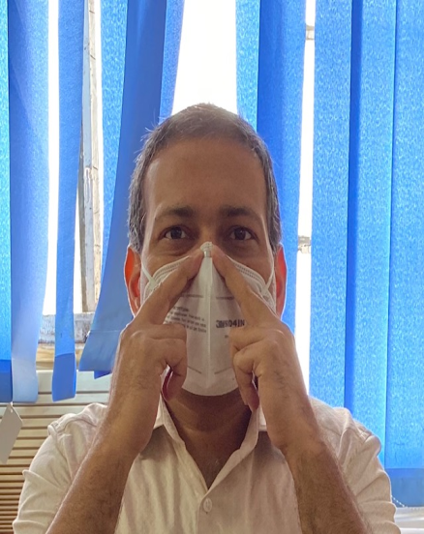
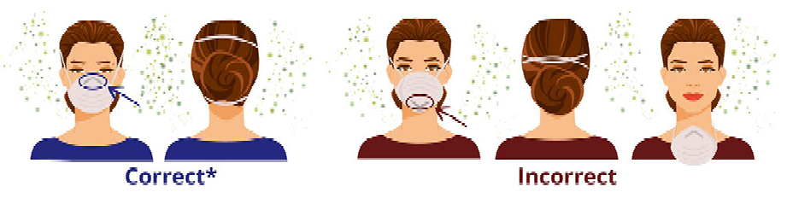
Fit test- Tighten the metal nose clip around nose and Exhale to check air leak

Slide 76
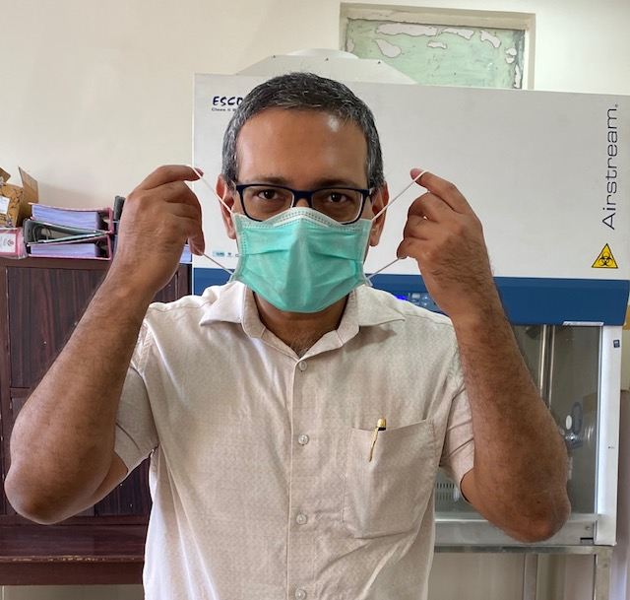
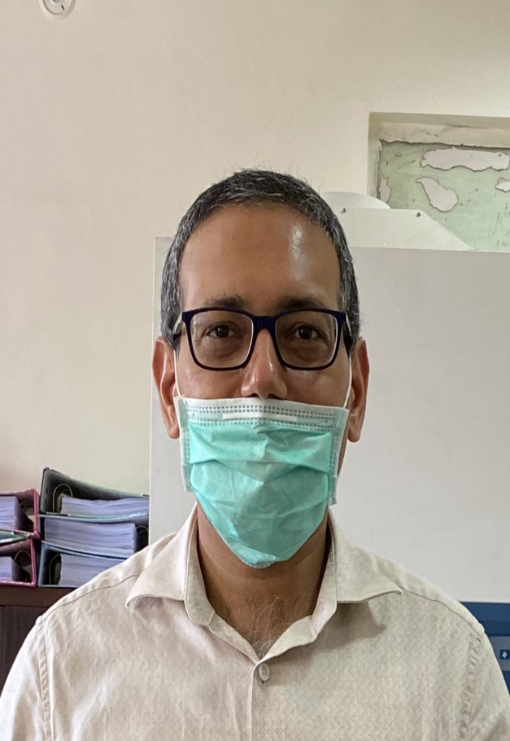
How to wear mask?
X
Wear the strings behind over the ear
Wrong way to wearing mask

Slide 77
Learning Objectives
To know the importance of hand hygiene
To know when to do a hand hygiene
To know the methods of hand hygiene
To know the correct steps of hand hygiene
To know the mask types
To know the correct method of wearing a mask

Slide 78
Any Questions?
?

Slide 79
Summary
Hand hygiene with either soap and water or with alcohol based hand rub is a must
Always do 7 steps of hand hygiene
Wear the mask correctly
Always cover both nose and mouth properly with the mask.
Do a fit test of N 95 mask
Do not touch front of mask with hands while working or thereafter

Slide 80
Donning and Doffing PPE
(Module 5)

Slide 81
Steps of Donning PPE
Remove home clothes, jewelry, watches, electronic etc. and wear clean hospital scrubs
Check PPE kit for all components – Shoe cover, gloves, gown, mask, cap, eye shield, face shield
Sanitize hands as per WHO protocol
Sit on Chair and Wear shoe covers
Sanitize hands with alcohol based sanitizer
Wear first set of gloves
Wear gown – Arm sleeves of gown should cover the gloves
Wear Mask – Check for snug fit of mask by exhaling 3 times

Slide 82
Steps of Donning PPE (Cont..)
Wear Cap
Wear eye shield
Wear face shield
Wear 2nd pair of the gloves – should cover free end of arms of gown
Check gown fitness with help of companion

Slide 83
Steps of Doffing PPE
Sanitize hands with gloves
Sit on Designated dirty chair
Remove shoe covers by touching outer surface and discard in yellow bin. Perform hand hygiene
Remove outer gloves, discard in yellow bin and perform hand hygiene
Remove gown, discard in yellow bin and perform hand hygiene
Remove face shield, discard in yellow bin and perform hand hygiene
Remove eye shield by holding the straps, discard in yellow bin and perform hand hygiene
Remove cap, discard in yellow bin and perform hand hygiene

Slide 84
Steps of Donning PPE (Cont..)
Remove inner gloves, discard in yellow bin and perform hand hygiene
Wear another pair of sterile/unsterile gloves
Remove mask, discard in yellow bin and perform hand hygiene
Sit on clean chair and clean your shoes with alcohol swabs
Remove last pair of gloves and perform hand hygiene

Slide 85
Any Questions?
?

Slide 86
Clinical presentation of COVID-19 in pediatric population
(Module 10)

Slide 87
Expected learning after this talk…
Identification of pediatric symptoms/signs
Comparison of clinical presentation of this disease in pediatric versus adult population
Grades of clinical presentation of COVID-19 disease in pediatric population
What are the findings of few of recent studies on pediatric COVID-19 disease
Outlines of management.

Slide 88
Prerequisite…. To know..
All the general information about COVID-19 disease and most of the epidemiological points are common between children and adults population.
Therefore it is must to have listened and understood the details of SARS-COV2 virus and contacts, suspected contacts, close contacts, sample whom and who is a confirm covid-19 case
All the precautions, social distancing, masks and hand hygiene and cough attequettes etc….

Slide 89
Symptoms/signs
…similar to other viral respiratory illnesses
Fever: 41%
Cough
Nasal congestion
Sore throat
Nasal congestion
Asymptomatic
Children may be hypoxic without being breathless initially
Notes:
Memish, Z.A., et al., Middle East respiratory syndrome coronavirus disease in children. Pediatr Infect Dis J, 2014. 33(9): p. 904-6.
* Monto, A.S., J.S. Koopman, and I.M. Longini, Jr., Tecumseh study of illness. XIII. Influenza infection and disease, 1976-1981. Am J Epidemiol, 1985. 121(6): 811-22.
* Pan, X., et al., Asymptomatic cases in a family cluster with SARS-CoV-2 infection.Lancet Infect Dis, 2020.

Slide 90
Few uncommon other symptoms/signs…
Diarrhoea
Nausea/vomiting
Fatigue
Headache
Myalgia
Poor feeding or poor appetite
Notes:
* Memish, Z.A., et al., Middle East respiratory syndrome coronavirus disease in children. Pediatr Infect Dis J, 2014. 33(9): p. 904-6.
* Monto, A.S., J.S. Koopman, and I.M. Longini, Jr., Tecumseh study of illness. XIII. Influenza infection and disease, 1976-1981. Am J Epidemiol, 1985. 121(6): 811-22.
* Pan, X., et al., Asymptomatic cases in a family cluster with SARS-CoV-2 infection.Lancet Infect Dis, 2020.

Slide 91
Difference from adults in symptoms/signs
Fever and cough may not present at the beginning of disease
Initial presentation may be only gastrointestinal symptoms
Asymptomatic initial phase are not uncommon (So… important epidemiological repercussions!)
Notes:
* Pan, X., et al., Asymptomatic cases in a family cluster with SARS-CoV-2 infection.Lancet Infect Dis, 2020.
# Shen, K., et al., Diagnosis, treatment, and prevention of 2019 novel coronavirus infection in children: experts’ consensus statement. World J Pediatr, 2020.
@ Stockman, L.J., et al., Severe acute respiratory syndrome in children. Pediatr Infect Dis J, 2007. 26(1): p. 68-74.

Slide 92
Reports from large studies..
status presentation percentage
  Asymptomatic No clinical signs/symptoms, 4%
  Normal imaging
Mild Mild symptoms, including fever, 51%
fatigue, myalgia, cough
Moderate Pneumonia with symptoms or 39%
subclinical disease with
abnormal chest imaging
Severe Dyspnea, central cyanosis, hypoxia 5%
Critical Acute respiratory distress syndrome 0.6%
[ARDS], respiratory failure, shock,
or multi-organ dysfunction
Notes:
Shen, k., et al., Diagnosis, treatment and prevention of 2019 Novel Corona viral infection in children: experts’ consensus statement. World j pediatr 2020..

Slide 93
Reports from studies..
Incubation period-14 days (like adults), China →2-14 days (average 5.9 days)
Children of all ages at risk
Prevalence of asymptomatic infection is less understood
Duration of presymptomatic period not well known
Notes:
Kam KQ, Yung CF, Cui L, Lin Tzer Pin R, Mak TM, Malwald M, Li J, Chong CV, Nadua K, Tan NW, Thoon KC. Awell infant with Coronavirus disease 2019 (COVID-19) with high viral load. Clinical Infectious disease. 2020 Feb 28
Liu J et al., Connunity transmission of Acute Respiratory Syndrome Coronavirus 2, Shenjhen China, Emerging Infectious Disease, 2020. 26(6). http://wwwn.cdc.gov/eid/article/26/6/20/0239_article
Shen, K., et al., Diagnosis, prevention and treatment in novel corona virus infection in children: experts’ consensus statement. World J Pediatr, 2020

Slide 94
Reports from studies..
Mostly transmission by household exposure
Infants at higher risk of severe disease. (amongst pediatric age group lesser the age more predilection to develop severe disease).
Amongst pediatric age group rate of hospitalization more in infants or with co-morbidities
Notes:
China center for disease control and prevention. [The epidemiological characteristic of an outbreak of 2019 novel coronavirus disease (COVID-19) in China]. Zhonhua Liu Xing Bing Xue Za Zhi, 2020. 41 (2). 145-151.
Centers for disease control and prevention. Coronavirus 2020. Available from: http://wwwn.cdc.gov/coronavirus/2019_ncov/index.html; Assessed 6Mar 2010.
Shen, K., et al., Diagnosis, prevention and treatment in novel corona virus infection in children: experts’ consensus statement. World J Pediatr, 2020

Slide 95
Disease Burden..
Relatively fewer cases in children than adults
Complications milder cause ? → perhaps virus affinity more towards Upper Resp. Tract.
Disease burden→ 0.8% to 2.2% of confirmed cases
Notes:
Al-Taufiq, J.A., RF. Kattan, and JA Memish, Middle East respitory syndrome coronavirus disease is rare in children: An update from Saudi Arabia. World J Clin Pediatr, 2016. 5(4). P 391-396
Chan, J.F., et al., A familial cluster of pneumonia associated with 2019 novel corona virus indicating person to person transmission: A study of a family cluster lancet, 2020. 24: p. 24.
Shen, k., et al., Diagnosis, treatment and prevention of 2019 Novel Corona viral infection in children: experts’ consensus statement. World j pediatr 2020..

Slide 96
Reports from studies:
Limited data for pediatric ages, findings not
specific for COVID-19
Leucocyte abnormalities may not always accompany
Notes:
World Health Organization- People’s Republic of China joint mission. Report of WHO-China Joint Mission on Corona Virus Disease 2019 (COVID-19). Available at https://www.who.int/docs/default-source/who-china-joint-mission-on-co-19-joint-mission-final-report.pdfpdf iconexternal icon; accessed 6 Mar 2020

Slide 97
Reports from studies:
X-ray chest → patchy infiltrates (consistent with viral pneumonia)
Chest CT Scan→ Nodular ground glass appearance
Absent radiographic findings possible
Notes:
Xia w., et al., Clinical and CT features in pediatric patients with COVID-19 infection: Different points from adults. Pediatric pulmonology.2020; 16. https:// onlinelibrary. Wiley.com/doi/full/10.1002/ppul.24718external icon.

Slide 98
SARI in children:
Fever of moderate degree and
Tachypnea/respiratory distress
[→fast breathing:
<2 months, ≥60;
2–11 months, ≥50;
1– 5 years, ≥40]

Slide 99
Clinical syndromes associated with COVID - 19 infection
Uncomplicated URI like illness (?Immunosuppressed?)
Mild illness
Severe Pneumonia
ARDS
Sepsis
Septic shock
Severer disease in lesser age and co-morbidities

Slide 100
Investigations…
Testing should be according to local guidance for management of community-acquired pneumonia. Examples of other etiologies include Streptococcus pneumoniae, Haemophilus influenza type B, Legionella pneumophila, other recognized primary bacterial pneumonias, influenza viruses, and respiratory syncytial virus.

Slide 101
Supportive therapy
O2 → target SpO2 ≥94%; otherwise, the target SpO2 is ≥90%.
Antibiotics
Oral/ tube feed or IV Fl.
Antipyretics only when needed.
Keep comorbidities in mind

Slide 102
ICU Requirements in COVID
Chinese pediatric cases→ 5.9% of all pediatric cases
high-risk pediatric population includes children with comorbidities e.g.:
→Congenital heart disease,
→Broncho-pulmonary hypoplasia,
→Airway/lung anomalies,
→Severe malnutrition, and
→Immunocompromised state;

Slide 103
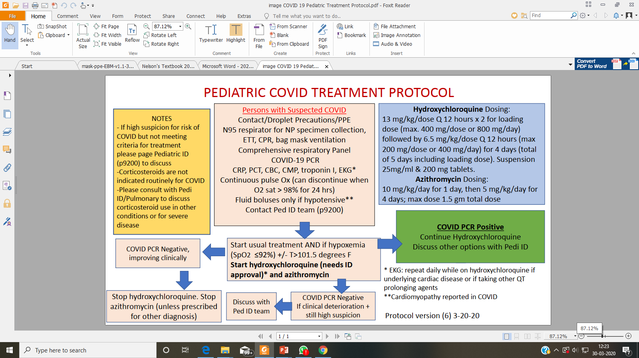
Boston Children …(one of associated hospitals)

Slide 104
Other Therapeutic Measures:
progressive deterioration of oxygenation indicators, rapid worsening on
imaging and excessive activation of the body’s inflammatory response, glucocorticoids can
be used for a short period of time (3 to 5 days). It is recommended that dose should not
exceed the equivalent of methylprednisolone 1 – 2mg/kg/day

Slide 105
Lopinavir/ Ritonavir to be considered in Laboratory confirmed cases of
COVID – 19 when the following criteria are met:
Hypoxia
Hypotension
New onset organ dysfuntion
High risk : RF, DM, CLD, immunocompromised

Slide 106
Any Questions?
?

Slide 107
To Summarise:
Try and recollect that…
Common clinical symptoms and signs
Paediatric disease v. adult disease
Findings from recent studies
Clinical spectrum (grades of illness)of pediatric COVID-19 disease is wide
Outline of management.

Slide 108
Have faith and confidence in yourself, system and much more in God….

Slide 109
Clinical presentation of COVID-19 in Pregnant Women
(Module 11)

Slide 110
Learning Objectives
At the end of this session, you should be able to
Assess risk and severity of illness in pregnant women with COVID 19 infection
Identify common clinical signs/symptoms of COVID-19 in pregnant Women
Compare clinical presentation of COVID 19 in pregnant population with other non pregnant adults
Appraise findings from recent studies on COVID-19 presentation in pregnant population
Understand the basic tenets of management of patients presenting with Obs & Gyn problems

Slide 111
Risk
According to information from CDC, they have same risk as other adults of acquiring COVID 19 infection*
But we also know that………..
Changes in their bodies may increase their susceptibility to any kind of infections.
They have higher risk of severe illness with viruses from the same family as COVID-19
* https://www.cdc.gov/coronavirus/2019-ncov/need-extra-precautions/pregnancy-breastfeeding.html

Slide 112
Mother-baby Transmission
Transmission is unlikely during pregnancy*
Virus is not detected in amniotic fluid, breastmilk, or other maternal samples*
Still, a few (very small) of babies acquired infection shortly after birth, but source unknown*
No evidence of teratogenicity
* https://www.cdc.gov/coronavirus/2019-ncov/need-extra-precautions/pregnancy-breastfeeding.html

Slide 113
Signs/Symptoms
Signs/symptoms of COVID 19 are similar as found in other adults
Clinical manifestations may vary from asymptomatic to very severe, similar to non-pregnant patients.*
* Liu Y, Chen H, Tang K, Guo Y. Clinical manifestations and outcome of SARS-CoV-2 infection during pregnancy. Journal of Infection. 2020 Mar 4.

Slide 114
Clinical course:
Reports from literature #:
Risk of severe disease in pregnant women (8%) was less than the risk reported in general population with Covid-19 in mainland China (15.7%)*
Some patients presented with exacerbations of respiratory disease during postpartum period, most likely associated with pathophysiological changes of their bodies (e.g., increased circulating blood volume)*
* Chen L, Li Q, Zheng D, Jiang H, Wei Y, Zou L, Feng L, Xiong G, Sun G, Wang H, Zhao Y. Clinical Characteristics of Pregnant Women with Covid-19 in Wuhan, China. New England Journal of Medicine. 2020 Apr 17.

Slide 115
Clinical course:
Reports from literature:
Evidence on severe maternal or neonatal outcomes uncertain *
Severe outcomes, if present are limited to infection in third trimester*
Some severe outcomes- rupture of membranes, fetal distress and preterm birth*
* Zhu H, Wang L, Fang C, Peng S, Zhang L, Chang G et al. Clinical analysis of 10 neonates born to mothers with2019-nCoV pneumonia. Transl Pediatr. 2020;9(1):51-60. Epub 2020/03/11. doi: 10.21037/tp.2020.02.06.
* Chen H, Guo J, Wang C, Luo F, Yu X, Zhang W et al. Clinical characteristics and intrauterine vertical transmission potential of COVID-19 infection in nine pregnant women: a retrospective review of medical records. Lancet. 2020;395(10226):809-15.

Slide 116
Clinical course:
Reports from literature:
A meta-analysis reported with eighteen articles between December 8, 2019 and April 1, 2020 including data from 108 pregnancies*
Data shows - women presented in third trimester with fever (68%) and coughing (34%) Lymphocytopenia (59%) with elevated C-reactive protein (70%)*
* Zaigham M, Andersson O. Maternal and Perinatal Outcomes with COVID‐19: a systematic review of 108 pregnancies. Acta Obstetricia et Gynecologica Scandinavica. 2020 Apr 7.

Slide 117
Clinical course:
Reports from literature:
A meta-analysis reported with eighteen articles between December 8, 2019 and April 1, 2020 including data from 108 pregnancies*
Data shows - women presented in third trimester with fever (68%) and coughing (34%) Lymphocytopenia (59%) with elevated C-reactive protein (70%)*
* Zaigham M, Andersson O. Maternal and Perinatal Outcomes with COVID‐19: a systematic review of 108 pregnancies. Acta Obstetricia et Gynecologica Scandinavica. 2020 Apr 7.

Slide 118
Clinical course:
Reports from large studies#:
Pregnancy and childbirth had no effect on aggravating course of symptoms or CT features of COVID-19 pneumonia*
* Liu D, Li L, Wu X, Zheng D, Wang J, Yang L, Zheng C. Pregnancy and perinatal outcomes of women with coronavirus disease (COVID-19) pneumonia: a preliminary analysis. American Journal of Roentgenology. 2020 Mar 18:1-6.

Slide 119
Tenets of Management
Antenatal period
When patient comes for admission

Slide 120
During Antenatal Period
Measures to reduce chances of infection
Antenatal visits & other antenatal services
  Minimum visits
  Care by telemedicine
  Healthy diet
  Regular exercise
Psychological support

Slide 121
Care when Patient comes for Admission
Triage
Screening
Positive
Negative
Send sample
If no urgency then no intervention till report available
If urgent need then treat as positive
All patients MUST be made to wear mask
Ward

Slide 122
Obstetric Management
All cases of suspected/ proven covid infection should be managed in a separate ward by a separate team
All patients MUST wear triple layer surgical mask
Ward must have proper donning & doffing areas with separate entry & exit for patients & staff
Minimum staff should enter the ward for minimum time & follow all infection prevention guidelines
Ensure patient is able to communicate by phone
No attendants allowed
Steroids if indicated due to prematurity must be discussed with patients & attendants & then given. Steroids not to be given for covid infection

Slide 123
Monitoring
Hourly SpO2 must be monitored & oxygen has to be given to maintain SpO2 > 94% if required
Strict input output monitoring must be done ensuring neutral fluid balance
Chances of fetal distress higher due to respiratory compromise of mother so if facilities available continuous monitoring should be done

Slide 124
Route of Delivery
Patient maybe left for vaginal delivery as virus not detected in vaginal secretions
Second stage maybe cut short by forceps/ventouse if patient is exhausted
Epidural analgesia maybe given during labour if required
Cases in early labour and with severe respiratory compromise should be terminated by caesarean section

Slide 125
Operative Delivery
Caesarean section may also be indicated for obstetrical indications
Regional anaesthesia is preferred due to high aerosol generation with general anaesthesia
Decision to delivery interval is increased in these cases due to time taken in donning PPE & also because patient must be anaesthetised prior to the surgical team entering the OT

Slide 126
Postnatal Management
Resuscitation of baby must be carried out in separate room
If not possible then maintain at least distance of 2m and use intervening screen
Baby must be tested for COVID infection
Rooming in to be avoided with baby being cared for by a healthy relative
Evaluate mother for need of anticoagulants
NSAIDS NOT to be given

Slide 127
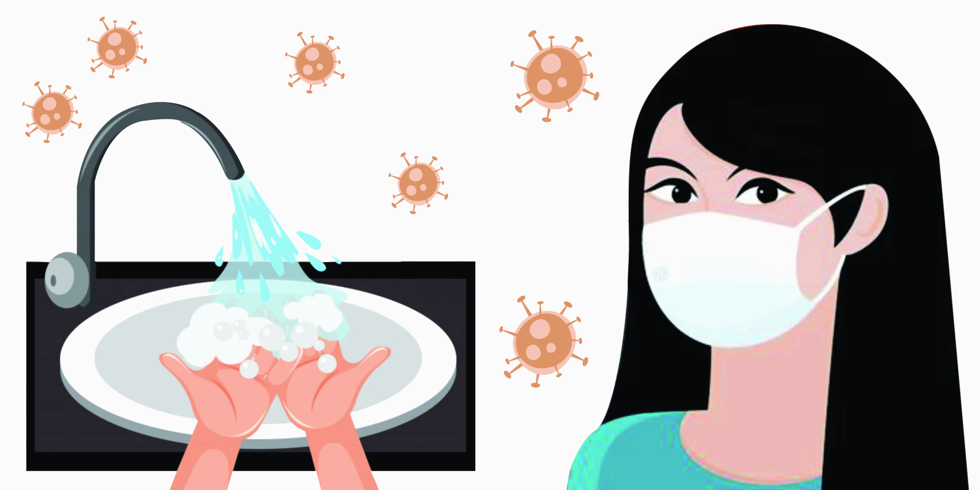
Neonatal Feeding
Virus has not been detected in breast milk
Breast milk is best for neonate
If mother infected but well she may breastfeed with proper precautions of hand washing & wearing mask
If mother not well but able to express milk then hygienically collected breast milk may be fed by healthy attendant
If not possible to express breast milk then top feed

Slide 128
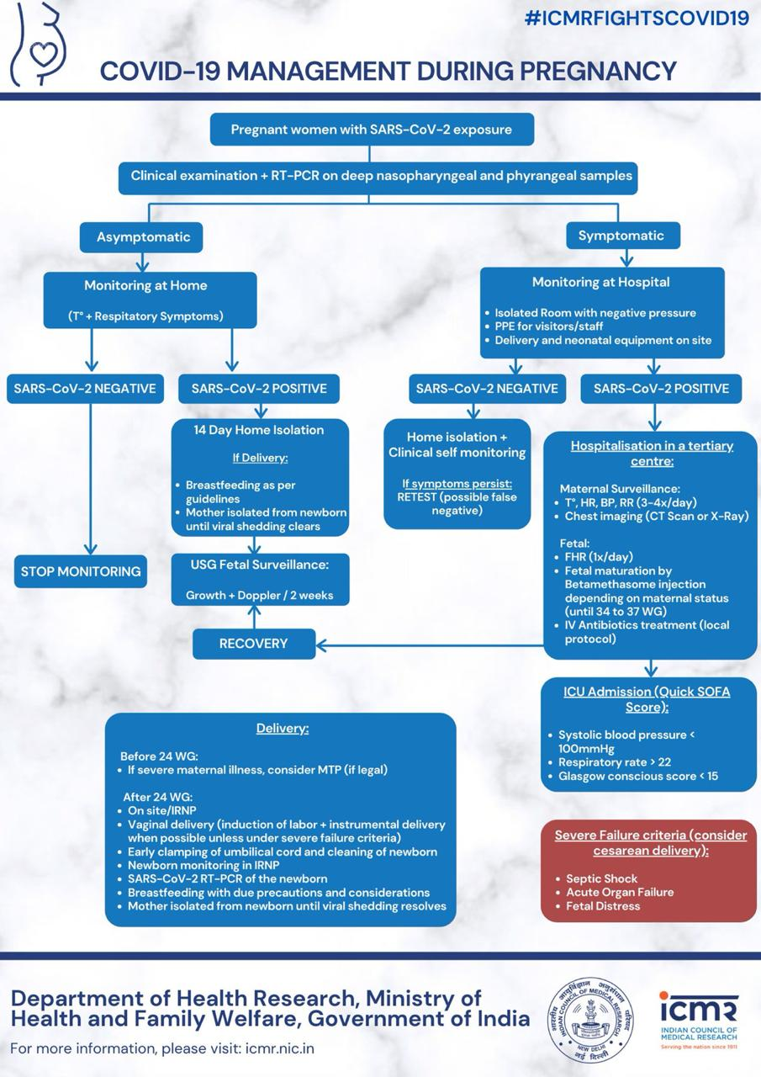

Slide 129
Any Questions?
?

Slide 130
To Summarize…..
Reflect and see if you will be able to:
Assess risk and severity of illness in pregnant women with COVID 19 infection
Identify common clinical signs/symptoms of COVID-19 in pregnant Women
Compare clinical presentation of COVID 19 in pregnant population with other non pregnant adults
Appraise findings from recent studies on COVID-19 presentation in pregnant population

Slide 131
To Summarize…..
Reflect and see if you will be able to:
Counsel in antenatal period
Treat all suspects as positive
Vaginal delivery possible
Expressed breast milk is best

Slide 132
Positive Mental Health
(Module 12)

Slide 133

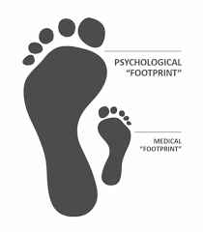

Slide 134

Health Care Workers (HCW)
Brave and selfless working
Preparedness
  Knowledge & Skills
  Psychological (Cognitive and emotional)
Buddy system- Pairing more experienced with less experienced HCW
Needs (Physical, psychological, social and spiritual)– Assessment and care

Slide 135
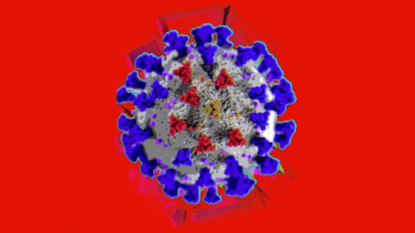

Evidence base
Small studies with sample from usually single institutions
SARS, MERS, Ebola, COVID-19

Slide 136

Mental health impact
11-20% of Health Care Workers (HCW) develop symptoms (emotional/behavioral/Somatic)^{1,2,3}
Common symptoms
  Stress related symptoms
  Anxiety, Depression, Somatization
  Insomnia, fatigue
  Substance use disorder
  Burnout
  Post Traumatic Stress Disorder (PTSD)

Slide 137
Factors that help reduce stress were as follows ⁴
Clear communication of directives and precautionary measures
Ability to give feedback to and obtain support from management
Support from supervisors and colleagues
Support from the family
Ability to talk to someone about their experiences
Religious convictions

Slide 138
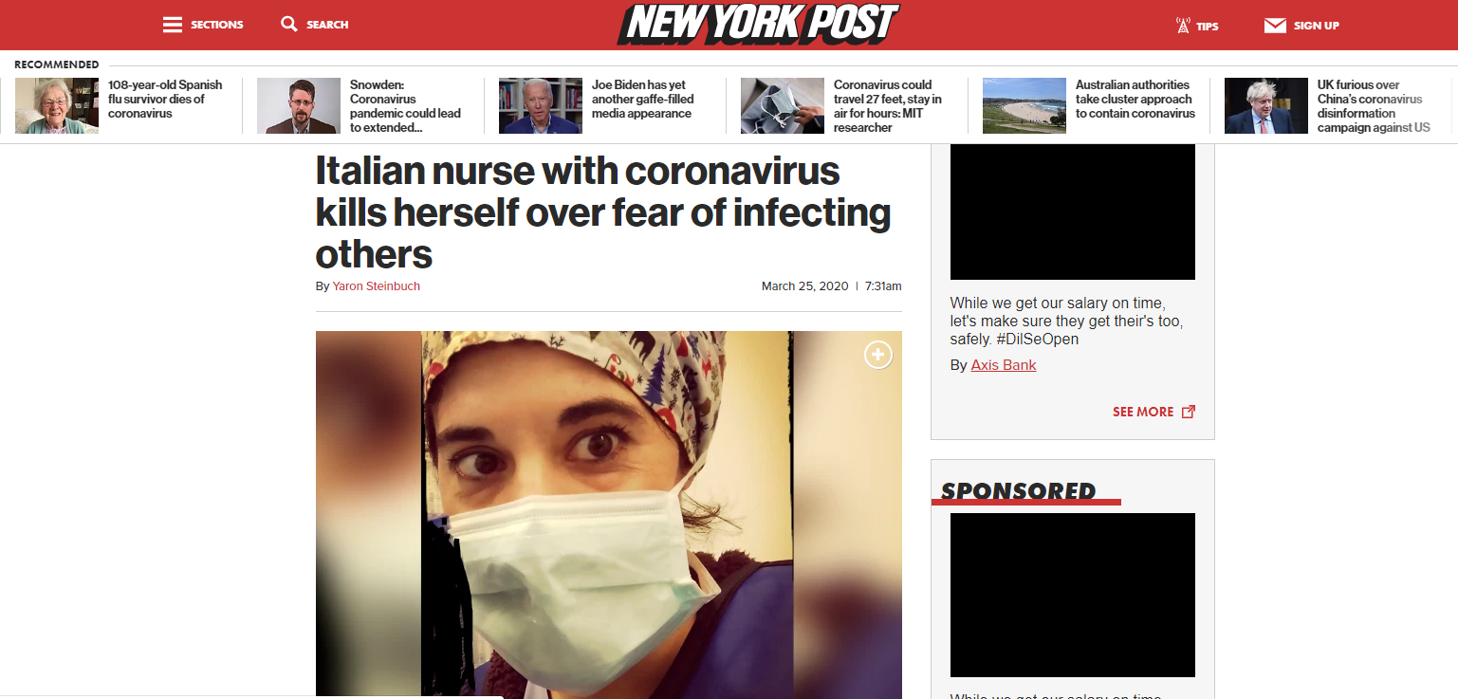
Getting infected was NOT a major worry

Slide 139

Fear
Risk to family, separation from family if quarantined
Unsure about their ability to work in the situation/ incapability with severe patients
Shortage of protective gears
Quality of food and resting facilities if need to stay at hospital
No need for individual mental health care for themselves but more rest and protective gears

Slide 140


Coping and resilience
Positive mental health

Slide 141



STRESS RESPONSE
FIGHT
FLIGHT
Anxiety, fear and distress are normative
emotional responses of threat and uncertainty (Accept)
Notes:
Walter cannon 1920

Slide 142
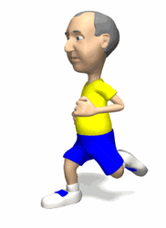


Basic Principles
Increasing physical reserve.
Increasing emotional reserve.
Reducing the intensity of the emotional reactions.

Slide 143





Having A Healthy
Lifestyle
4 km of walking, walking/jogging
20 minutes of swimming
45 min. Of several rounds of tennis/day
Some daily exercise is better than none
Regular Aerobic
Exercise:
* 3-7 times/week
Sleep (7-8 hours)
Limit Caffeine, Nicotine, Alcohol
or Other Psychoactive Substances

Slide 144
Situation
Thought
Emotions
Physical sensations
Behaviour
*Understand link - thinking, emotions, behavior and bodily symptoms
*Watch your thoughts - Positive self talk
Notes:
Presenter: SKK
3 minutes

Slide 145

Social contagion
Like Corona virus, behavior and emotions are also contagious
Spread hope, optimism, happiness and compassion.
Avoid spreading doubt, pessimism, cynicism, shaming and blaming (Talk to specialist)
Be a role model for others
Altruistic acceptance of work related risk
Social Contagion

Slide 146


Points to remember
Ensure adequate sleep and physical rest
Take balanced diet
Utilize free time in doing what makes you happy and relaxed – Hobbies, dance, music, poetry, gardening, pet
Judicious use of screens

Slide 147


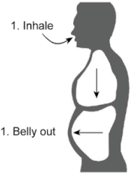

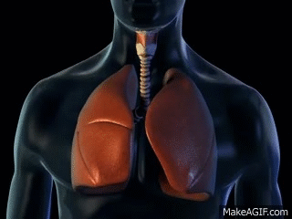
Relaxation

Slide 148
Other resources

Slide 149


Online resources
Please seek information from only reliable resources i.e WHO, GOI website
      Helguide.org
free online resource
Authentic and useful information

Slide 150
References
Lu YC, Shu BC, Chang YY, Lung FW. The mental health of hos- pital workers dealing with severe acute respiratory syndrome. Psychother Psychosom. 2006;75(6):370–5.
Mak IW, Chu CM, Pan PC, Yiu MG, Chan VL. Long-term psychiatric morbidities among SARS survivors. Gen Hosp Psychiatry. 2009;31(4):318–26.
McAlonan GM, Lee AM, Cheung V, Cheung C, Tsang KW, Sham PC, et al. Immediate and sustained psychological impact of an emerging infectious disease outbreak on health care workers. Can J Psychiatr. 2007;52(4):241–7.
Chan AO, Huak CY. Psychological impact of the 2003 severe acute respiratory syndrome outbreak on health care workers in a medium size regional general hospital in Singapore. Occup Med (Lond). 2004;54(3):190–6.

Slide 151

Support
Helpline for KGMU HCW
Department of Psychiatry
If you feel overwhelmed or stressed, contact us on
09511119123 (Confidential)
10 AM to 4 PM (Daily)

Slide 152
Any Questions?
?

Slide 153
Hospital Environment Cleaning with special reference to COVID 19
(Module 13)

Slide 154
Learning objectives
Survival of virus on surfaces
Surfaces to be cleaned in vicinity of patient
Cleaning of small instrument surfaces
Cleaning of High Touch & Low touch surfaces
Sterilisation & Disinfection of COVID Operation theatre
Environmental cleaning of Patient areas
Environment cleaning of surfaces outside patient area
Floor and Wall cleaning
Laundry

Slide 155
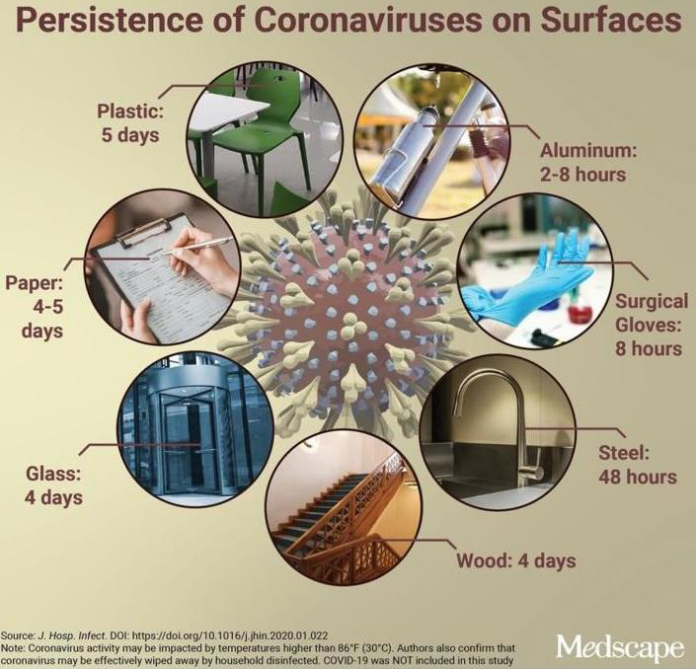
SARS CoV-2 survival on various surfaces

Slide 156
Environment & equipment surfaces to be cleaned and disinfected daily
Bed rails,
Bed matress
I.V pole
Medicine trolly
Monitors
Ventilator tubings/ surfaces
Keyboard
Telephone receivers
Door handles/knobs
Stethoscope diaphragm/ other components
Floor & walls
Window sills
Sister desk
Table surfaces
Almirah handles and surfaces
Toilet seats and its surfaces (including floor and walls of toilets)
Toilet taps/ health faucets

Slide 157
Cleaning of small equipments
Use 70% isopropyl alcohol:
  Stethoscope
  BP cuffs
  Rubber stoppers of multi-dose vials
  Small instrument surfaces

Slide 158
General Principles of Cleaning & Disinfection
Wear appropriate PPE before starting cleaning and disinfection.
Clean any surface 1st with detergent and water followed by appropriate disinfectant.
Disinfect metal surfaces with 70% Alcohol
Separate mop for different areas (Patient area, corridors, lab area, offices etc.)
DO NOT USE DRY BROOM/VACUUM CLEANERS
Remove PPE at doffing area after work completion
After removing PPE perform hand hygiene with soap and water.

Slide 159
General Principles of Cleaning & Disinfection
After cleaning:
  Discard disposable pads/cloths: in yellow bag
  After cleaning, wash the cloth with detergent and sun dry
  Launder mop heads daily
  All washed mop heads must be dried thoroughly before re-use.
  Clean sanitation cart and carts used to transport biomedical waste daily.

Slide 160
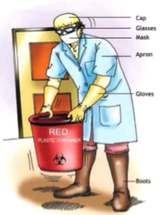
PPE for Cleaners/ sweepers includes the following:
  Impermeable plastic apron
  Gum boots
  Disposable mask and caps
  Gloves
  Eye protection wherever required

Slide 161
High-touch surfaces
Also known as frequently touched surfaces
Examples:
  Almirah handles
  Telephones, call bells, computer keyboards
  Light switches, edges of privacy curtains
Require more frequent cleaning and disinfection
Cleaning and disinfection is to be done daily at least 3-4 times a day.

Slide 162
Low-touch surfaces
Surfaces that have minimal contact with hands
Examples:
  Walls and ceilings
  Mirrors and window sills
Require cleaning on a regular (but not necessarily daily)
When soiling or spills occur,
High & moderate risk areas- Daily
Low risk areas- weekly/ monthly

Slide 163
OT Cleaning & Disinfection
Sterilisation: By fogging with H2O2 based disinfectant (e.g 7.35% w/v H2O2 and 0.23% w/v peracetic acid or H2O2)
Surface disinfection: with same disinfectant or with 1% hypochlorite.
Walls and floor- 1% hypochlorite/ bleaching powder solution

Slide 164
Surgical Instrument Cleaning & Disinfection
Metal instrument:
Cleaning- 1st with enzymatic solution/ neutral detergent & water
Sterilisation- Autoclaving
Heat sensitive instruments: by PLASMA STERILISERS (e.g endoscope)

Slide 165
Environment surfaces within Isolation (Corona ward)
Cleaning- 1st with detergent & water
Disinfection of surfaces: H2O2 wipes; Contact time 1 minute (BS Hydro)
Wall & Floor: 7.35% H2O2 with 0.23 % peracetic acid; Contact time 5 minutes (BS Peroxy)
Frequency: 4 times/ day
Wall: up to 7 ft height

Slide 166
Environment surfaces in Quarantine rooms & outer corridors of Isolation & Quarantine area/ Lift/ Triage
All surfaces including walls and floor
Cleaning: detergent & water
Disinfectant- 1% Hypochlorite
Metal surfaces in lift switches, railings, chairs etc: 70% alcohol

Slide 167
Cleaning of floors
Remove gross soil prior to cleaning and disinfection with gloved hand/ wiper
If any needle or sharps are there in the floor segregate in puncture proof box safely
Use dust control mop prior to wet mop
Do not lift dust mop off the floor use swivel motion,
Never shake the mop

Slide 168
Progress from the least soiled areas (low-touch) to the most soiled areas (high-touch)
From high surfaces to low surfaces
Wash the mop under running water before doing wet mopping
An area of 120 square feet to be mopped before re-dipping the mop in the solution
Cleaning solution to be changed after cleaning an area of 240 square feet
Change more frequently in heavily contaminated areas, when visibly soiled and immediately after cleaning blood and body fluid spills

Slide 169

Mopping Floors using Wet Mop and Bucket
Prepare fresh cleaning solution
Place ‘wet floor’ caution sign outside of room or area being mopped
Divide the area into sections
Immerse mop in cleaning solution and wring out
Push mop around paying particular attention to removing soil from corners
avoid splashing walls or furniture
Do figure of 8 stroke
Notes:
(eg. Corridors may be divided into two halves, lengthwise, so that one side is available for movement of traffic while the other is being cleaned.)

Slide 170
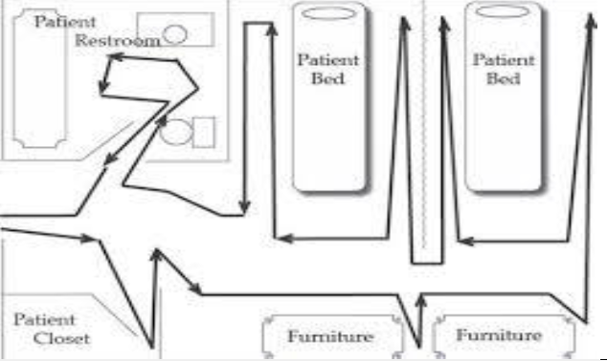
Mopping Floors using Wet Mop

Slide 171
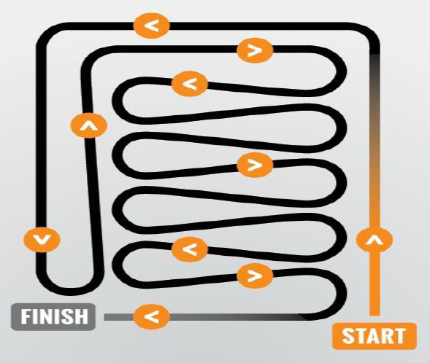
Technique for mopping with wiper

Slide 172
Triple bucket system
Floor cleaning
Procedure for washing, rinsing, and sanitizing where a different bucket and sponge or mop is used for each task
For washing:
  First bucket with water and detergent is used only for this purpose and will not be used for rinsing or sanitizing
For Rinsing:
  Second bucket with water only, will be used solely for this purpose.
A third bucket:
  Containing water and a disinfectant solution shall be used for disinfection only

Slide 173

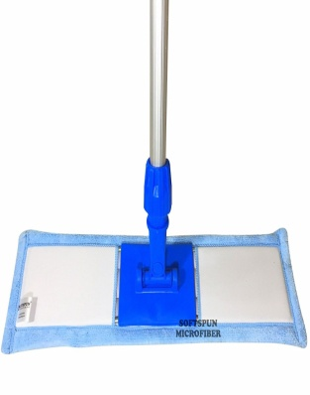
Mopping Floors using Wet Mop and Bucket
Water + detergent
Only water
Water + disinfectant

Slide 174
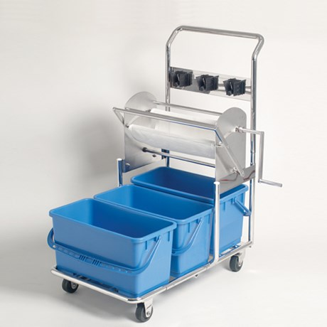
Triple bucket system

Slide 175
Terminal Cleaning/ disinfection of patient room after discharge
Fogging: H2O2 based disinfectant (e.g 7.35% w/v H2O2 and 0.23% w/v peracetic acid or H2O2)
Surface disinfection: with same disinfectant or with 1 % hypochlorite.
Walls and floor- 1 % hypochlorite/ bleaching powder solution
Patient belongings- Disinfect thoroughly with H2O2 wipes/ 70% alcohol (Contact time 1 minute)

Slide 176
Disinfecting Ambulance
Wear full PPE
Cleaning 1st: Detergent & water
Disinfect all surfaces: 1% hypochlorite solution.
Metal surfaces: 70% alcohol
Floor of ambulance: 1 % hypochlorite solution

Slide 177
Laundry/ cleaning and disinfection of isolation room after patient discharge

Slide 178
Laundring patient clothes/ bed linen
Wear full PPE
Place soiled cloths in designated container for laundering
Do not shake the clothes/linen
Patient clothes laundry is to be done by dipping in 1 % hypochlorite solution for 30 minutes followed by washing with detergent and hot water (70 ºC)
Or the patient may dispose clothes in yellow bins for incineration

Slide 179
Any Questions?
?

Slide 180
Summary
Wear appropriate PPE
Clean surfaces 1st with detergent & water
Disinfect surfaces with appropriate disinfectant
Disinfect metal surfaces with 70% alcohol
Use separate mops for different rooms/ area
Do not shake the mop/ patient cloths/ bed linen
Wash hands with soap and water after removing PPE

Slide 181
Biomedical Waste Management & Dead Body Disposal for COVID 19
(Module 14)

Slide 182
Learning Objectives
Different Category of Biomedical waste & waste disposal
Labelling of waste
Spill Management
Hypochlorite and Bleaching powder solution preperation
Dead Body handling

Slide 183
General guidelines at KGMU for COVID waste
COVID-19 Isolation wards/ quarantine facility/ triage/ OPD
Responsible person to implement: Nursing supervisor
Responsibility: everyone
Separate colour coded bins / bags / containers
Double layered bags (using 2 bags)
Storage of BMW in a designated area by the respective ward/ department
Common biomedical waste treatment facility (CBWTF): Shall collect waste from yellow bins
Other waste: UED

Slide 184
General guidelines at KGMU for COVID waste
Mandatory labelling, bags / containers used for collecting BMW from COVID19 ward: COVID 19 waste
Separate record is maintained for COVID-19 BMW
Dedicated trolleys and collection bins
Inner and outer surfaces of bins to be disinfected with 1% sodium hypochlorite solution daily.
Ensure that SPILL KIT is present at all stations.

Slide 185
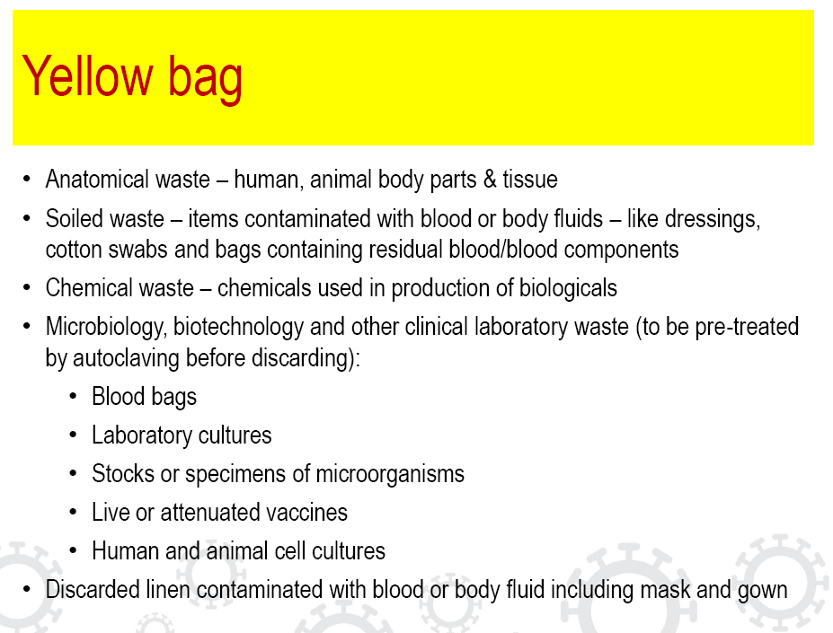
Gloves in Yellow
at isolation ward only
All patient food waste
at isolation ward

Slide 186
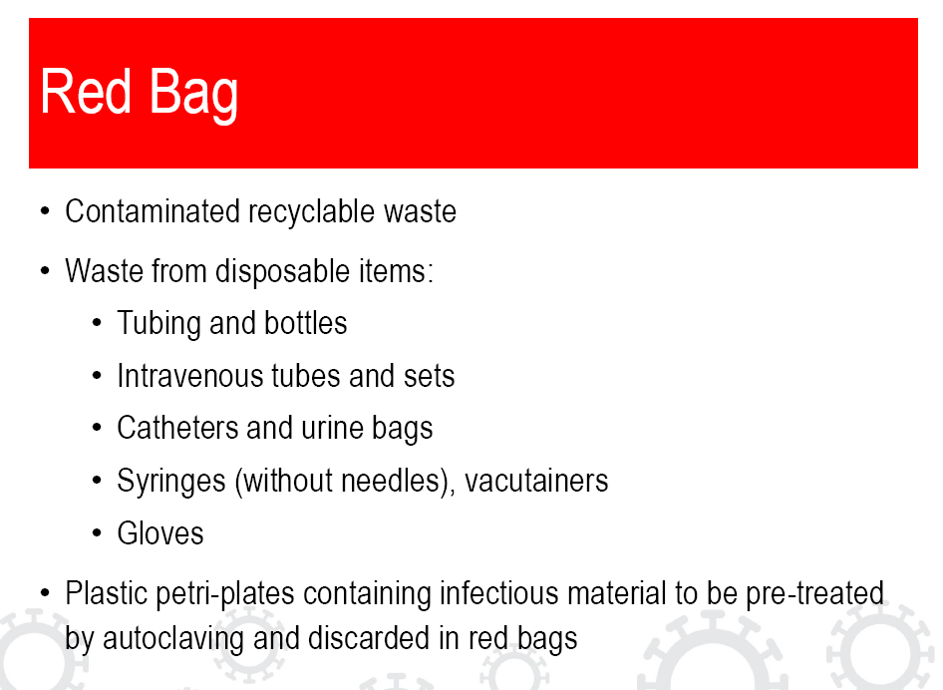
All Plastic waste (food plastic
/water bottles at
quarantine/isolation ward

Slide 187
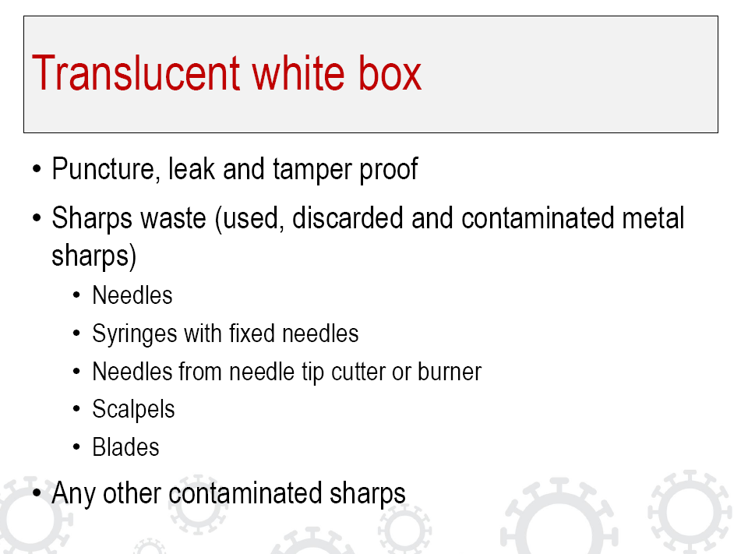

Slide 188
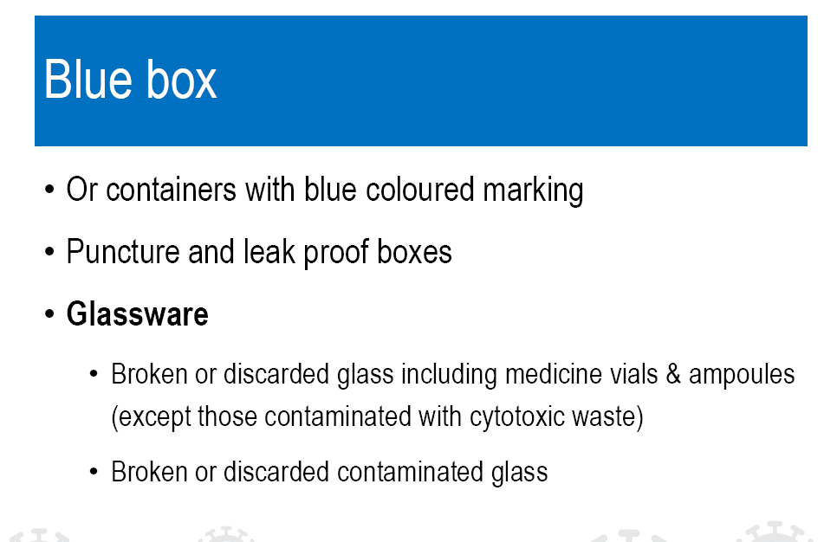

Slide 189
Black Bin
Only in quarantine area/ office area/ trauma emergency area.
Treat the non infected routine waste as general solid waste and dispose to local municipal as per SWM rule, 2016.

Slide 190
Labelling of Waste
All waste has to be in double layered medical waste bags.
Label the waste as COVID-19 waste
Spray 0.5% hypochlorite to decontaminate outer surface

Slide 191
Spill Management
Cover the spill with absorbent cotton or a cloth.
Disinfect the surface with 1% bleach for 10-15 minutes.
Collect the spill with scoop and discard it in the yellow/ red bag.
Finally mop with detergent and water.

Slide 192
Hypochlorite solution and Bleach preparation for floor &wall disinfection
1% Bleaching powder solution-
  Prepare 33 gms of bleaching powder (bleaching powder with 30% strength) in 1 litre of water.
1% Hypochlorite solution- For instrument and bench and small spill
  Prepare by mixing 200 ml (of 5% available chlorine hypochlorite ) in 800 ml of water.

Slide 193
Handling dead bodies
Wear full PPE
Remove all tubing's and discard in appropriate bin.
Fill all openings of dead body with cotton balls or gauge dipped in 1% hypochlorite.
Wrap the body with double layer cloth soaked in 1% hypochlorite
Wrap again in leak proof wrapping sheet.
Disinfect the surface with 1% hypochlorite.
Inform CMO and hand over the body to the attendants.
In case of death of a suspect case ( Triage area) same steps to be followed.
Wear mask and gloves while transporting.

Slide 194
Any Questions?
?

Slide 195
Summary
Discard all components of PPE including gloves in Yellow bin
Use double layer of bags in bins
Discard infected plastics in Red bins
Discard infected sharps/ needles in white bin
Discard infected glass bottles in Blue bin
Prepare Hypochlorite/ bleaching powder solutions appropriately
Ensure spill kit presence at your ward/ area
Manage spill properly
Handle Dead bodies carefully

Slide 196
Flow of COVID Patients with Triaging – Current Scenario
(Module 15)

Slide 197
Learning objectives
Be aware of designated places for handling Corona patients in KGMU
Be aware of posting schedule
Be aware of different PPE practices at different places
Be able to guide patients of Corona and their relatives

Slide 198
Five Areas of COVID Patients
Fever OPD – New OPD 1st floor (Cabin)
Triage Ward – Old Neurology Building
Screening Emergency – Child Psychiatry Building
Isolation Ward
  &
Ventilator Unit
  For Positive Patient Deluxe Pvt. ward 3rd floor
    (opposite Neurology building)
  For Suspected
    (Deluxe Pvt. ward 1st floor)
  ICU & ventilator Unit
    (Deluxe Pvt. ward 1st floor)
  One place for Active quarantine
  (Super Deluxe ward Private rooms)

Slide 199
Flow of Patients-Fever OPD
Suspect & Stable
Non Suspect
Suspect & unstable
Isolation (Test + Treatment)
Treatment Accordingly
Triage
COVID Positive
COVID Negative
Respective ward for Treatment

Slide 200
Flow of Patient
Emergency Patient Screening OPD (Child Psychiatry)
Stable & Suspect
Unstable & Suspect
Non Suspect
Triage Area
(Old Neurology Building)
Isolation New Private Ward Building
(Test + Treatment)
Respective Wards for Treatment
Test
COVID Positive
COVID Negative
Respective Wards for Treatment

Slide 201
Details of Posting in Isolation and Triage Ward:-
Duration of Posting – 6 hours.
If use of washroom – Change PPE.
If water is required – Change mask and outer gloves with sanitization of inner gloves.
If more than one patient is to be attended – Change outer glove and mask and sanitize inner gloves.
Use of phone by doctor – Remove outer gloves, use speaker & clean phone with H₂O₂/70% Alcohol wipe and wear outer gloves after sanitization of inner gloves.
What to do during active quarantine? – Area D – To remain in O.T. Dress with mask (3 layers) till bath then own clothes.
Support staff of D area (Active quarantine) O.T. Dress + Mask (3 layer) + Cap.

Slide 202
PPEs for Designated areas
Isolation Ward:- A, B and C area + Triage area two types of PPEs:-
Single Piece (HAZMAT) with eye shield.
Cap, Head gear with shield, Spects, N-95, Gown(double breast), Additional Paizama on OT Dress, Shoe cover, 2 Pair Gloves.

Slide 203
Screening Area:-
Guard – Mask (3 layer) and Cap
Doctor – Talks from window with mic hence only 3 layer mask + Cap with shoe cover.
  Hand sanitizer to be used frequently.
Ambulance Driver and Cleaner:-
  PPE as for Isolation.

Slide 204
Fever OPD – Doctor & all staff:-
Double 3 layer mask/N-95, Cap, Shoe Cover, gloves.
Fever OPD Doctor and close contacts:-
Active quarantine
Other staff of Fever Clinic:-
Home Quarantine

Slide 205
Learning objectives
Be aware of designated places for handling Corona patients in KGMU
Be aware of posting schedule
Be aware of different PPE practices at different places
Be able to guide patients of Corona and their relatives

Slide 206
Any Questions?
?

Slide 207
Summary
Everyone must be well aware of COVID areas of Hospital
Everyone must help patients in directing the patients for designated area
COVID areas of Hospital are dynamic and may change as per need in future
Everyone must be DUTYFUL AND STAY PROTECTED while discharging their duties

Slide 208
Current Concepts of Isolation and Quarantine for health care workers
(Module 16)

Slide 209
Learning objectives
Be able to identify high risk and low risk HCW
Be able to understand basis and purpose of isolation and quarantine
Should know concepts of active and passive quarantine for healthcare workers (HCW)
To understand guidelines of home as well as in-house quarantine

Slide 210
Risk categories of HCW – High Risk
All HCWs working in ICUs in any area in COVID hospital
HCWs involved in performance of aerosol generating procedures such as
    Endotracheal intubation or extubation
    Cardio-pulmonary resuscitation (CPR)
    Application of non-invasive ventilation (NIV) or open air-way suctioning
    Bronchoscopy or tracheostomy
    Nasopharyngeal swab or Sputum or Broncho-alveolar fluid specimen collection
    Any protected contact of more than 15 minutes and at a distance less than 2 meters from a suspected or confirmed case

Slide 211
Risk categories of HCW – High Risk
    Any unprotected exposure to suspected or confirmed case
    Laundry workers
    Waste disposal staff
    Sanitary staff
    If any of the staff feels that there was a breach in personal protection during the entire duration of exposure while working in COVID hospital
    Any HCW who became symptomatic during the seven days work

Slide 212
Risk categories of HCW – Low Risk
A protected or unprotected exposure of less than 15 minutes
A protected exposure with a distance less than 2 meters and duration less than 15 minutes such as
    X-ray technician
    Porters involved in patient transport
    Kitchen staff
    Registration counter staff
    Security personnel
    Data entry operator
    Those involved in sample transport
  Protected HCWs involved in non-ICU setting

Slide 213
Isolation Versus Quarantine
Isolation:- Separation of individuals who are ill and suspected or confirmed to have COVID-19 infection
Quarantine:- Separation of individuals who are not yet ill but have been exposed to COVID-19 and have potential to become ill as well as infective

Slide 214
Purpose of Quarantine
To reduce transmission by -
Separating contacts of COVID-19 patients from community
Monitoring contacts for development of sign and symptoms of COVID-19
Segregation of COVID-19 suspects, as early as possible from among other quarantined persons

Slide 215
Indications for quarantine
All the contacts, regardless of their risk of exposure, shall be advised for quarantine
Duration of quarantine
Total duration of 14 days from the last exposure
Covid-19 testing of those on quarantine
All those on quarantine shall be tested for Covid-19 twice; once at the start of quarantine and second time at just before the completion of 14 days of quarantine period.

Slide 216
Why Quarantine?
Concepts of incubation period.

Slide 217
Active versus passive quarantine
Active Quarantine:- All HCWS while on duty for 7 days, will be mandatorily staying in-house quarantine
Passive quarantine:- Home quarantine for 14 days after 7 days duty is over

Slide 218
Corona Test during Quarantine
On development of symptoms at any point
Passive quarantine:- once at start and second just before completion of 14 days.
(Testing at start of passive quarantine may be omitted – Institutional policy)

Slide 219
Any HCW who develops symptoms and found positive for corona test during quarantine will be shifted to Isolation facility

Slide 220
Guidelines for Home quarantine of HCW
Uninterrupted 24x7 supply to food and water
Separate room with attached toilet
Room not be shared by other family members
No sharing of utensils and linen with family
HCW to monitor symptoms twice daily
Discard all disposable material in the hospital
Remove shoes and maximum possible cloths outside your house or in an isolated area at home

Slide 221
Guideline for Home quarantine for HCW
Keep bag packs and hospital stuff in a separate or dedicated area
Take bath immediately after entering the house
Change your remaining clothes and discard them in the laundry for separate cleaning
Maintain social distancing with family members
Maintain standard hygiene practices and respiratory etiquettes.
Stay away from children and elderly family members

Slide 222
In-House Quarantine
All the HCWs, regardless of their risk category and level of work, will preferably be accommodated in single accommodation if facilities are available
In condition of logistic problems or limited accommodation facilities, those with high risk category will be given preference for single accommodation and those with low-risk category will be accommodated on sharing basis
The sharing, if needed, will be done between 2-4 personnel depending upon the accommodation facility

Slide 223
Learning objectives
Be able to identify high risk and low risk HCW
Be able to understand basis and purpose of isolation and quarantine
Should know concepts of active and passive quarantine for healthcare workers (HCW)
To understand guidelines of home as well as in-house quarantine

Slide 224
Any Questions?
?

Slide 225
Summary
All HCW working in ICUs, aerosol generating places, laundry, BMW and sanitary area are at high risk of exposure to corona virus
Duration and distance of contact also decides risk category of HCW
Purpose of quarantine is to monitor HCW and keep his/her family safe
Active quarantine is in-house during duty period and passive quarantine is after duty in home
All HCWs should follow guidelines of home quarantine as well as in-house quarantine for safety of themselves and their family

Slide 226





Faculty and Contributors
Dr. Vinod Jain,
Dean
Faculty of Paramedical Sciences
Dr. Prashant Gupta
Associate Professor
Department of Microbiology
Dr Abhishek Singh
Associate Professor
Department of Microbiology
Dr. Siddharth Koonwar
Associate Professor
Department of Pediatrics
Prof. Anjoo Agarwal
Professor
Department Obstetrics & Gynecology
Prof. Kirti Srivastava
Professor
Department of Radiotherapy

